Slide 1
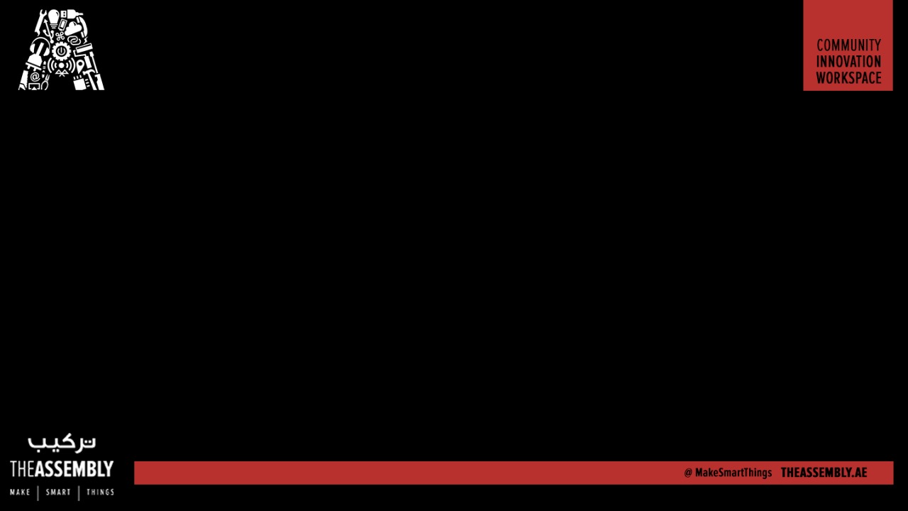
Control robots using Javascript through Cylon.js
Presented By : The Assembly Team
WiFi:- In5 Tech
Pass:- WelcomeToIn5

Slide 2
Getting started
Things to install:
NodeJS
Cylon.js
Arduino IDE
Code editor (Visual studio code/ Sublime Text)

Slide 3
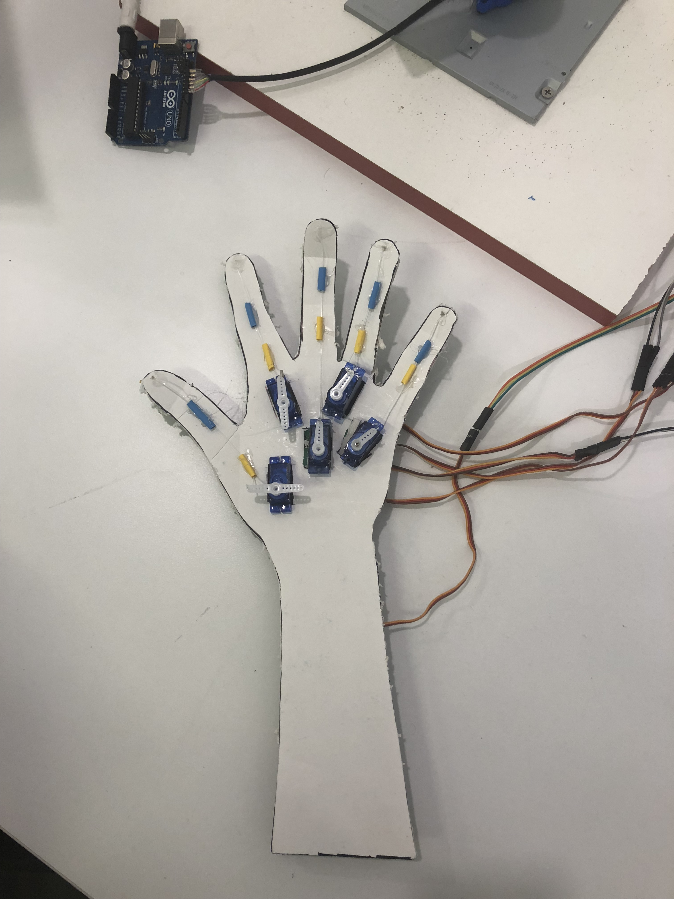
DEMO

Slide 4
Things to do
Introduction to Nodejs and Cylonjs
Working with Cylonjs and a keyboard
Blinking LED on Arduino
Servos
Using a keyboard to control the servos

Slide 5

NodeJS
Open source server environment
Uses Javascript
What can it be used for?
Web application frameworks
Access to wide variety of packages via npm

Slide 6

Cylon.js
A Javascript framework
What can it be used for?
Commanding robots
Internet of things

Slide 7
Cylon.js
To install Cylon.js
Using the terminal:
npm install cylon
npm install cylon-firmata cylon-gpio cylon-i2c
To use Cylon.js with the keyboard:
npm install cylon cylon-keyboard

Slide 8
Detecting keyboard input
Setting up requirements
"use strict";
var Cylon = require('cylon');
The “main” method
Cylon.robot({
//main code here
}).start();

Slide 9
Detecting keyboard input
Defining the connections (NOTE: CHANGE THE PORT)
connections: {
keyboard: { adaptor: 'keyboard' }
},
Defining the devices
devices: {
keyboard: { driver: 'keyboard' }
},

Slide 10
Detecting keyboard input
Prints ‘a pressed’ when the a key is pressed
work: function(my) {
my.keyboard.on('a', function(key) {
console.log("a pressed");
});
}

Slide 11
Detecting keyboard input
"use strict";
var Cylon = require('cylon');
Cylon.robot({
connections: {
keyboard: { adaptor: 'keyboard' }
},
devices: {
keyboard: { driver: 'keyboard' }
},
work: function(my) {
my.keyboard.on('a', function(key) {
console.log("a pressed");
});
}
}).start();

Slide 12
Detecting keyboard input
To run the script using terminal:
node keyboard.js

Slide 13
Now for the hardware…

Slide 14
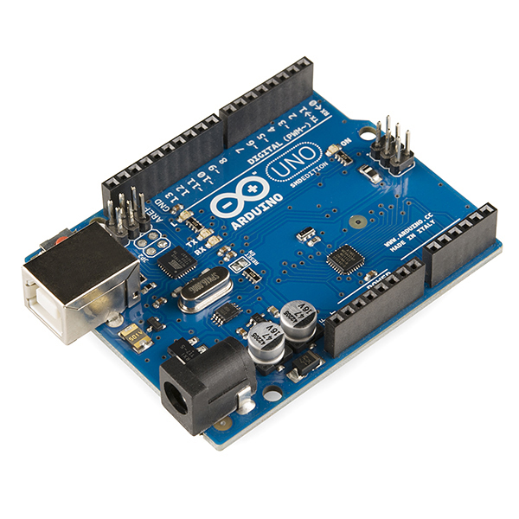
Arduino
A programmable microcontroller
What can it be used for?
Internet of Things
Controlling lights/sensors/motors

Slide 15
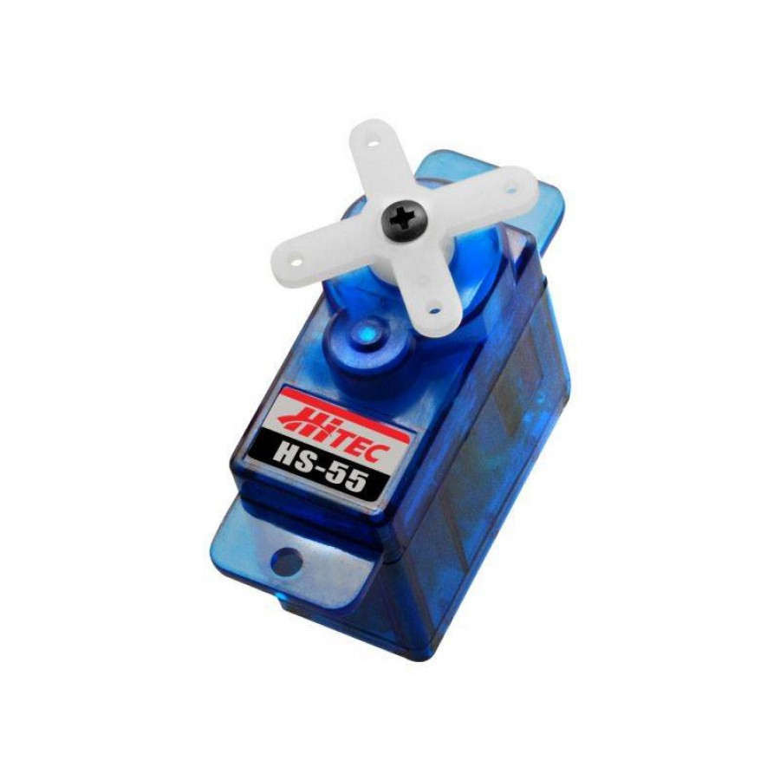
Servo motor
A rotary or linear actuator that allows for precise control of angular and linear position.

Slide 16
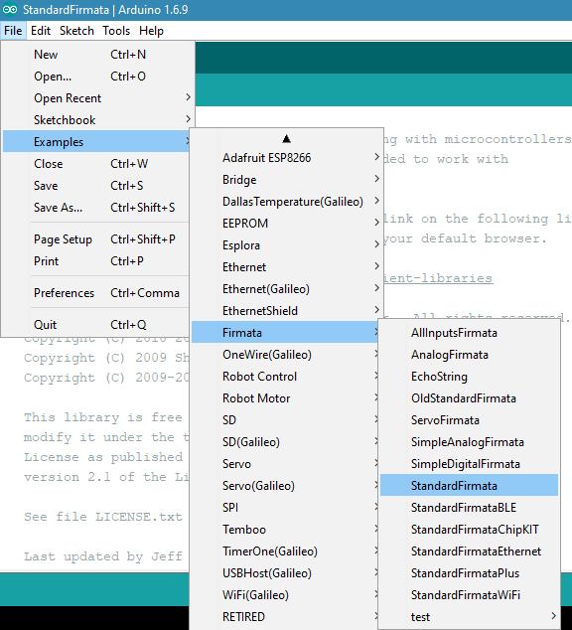
Uploading Firmata

Slide 17
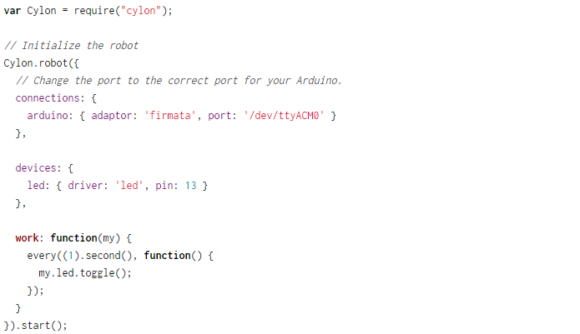
Blinking LED

Slide 18
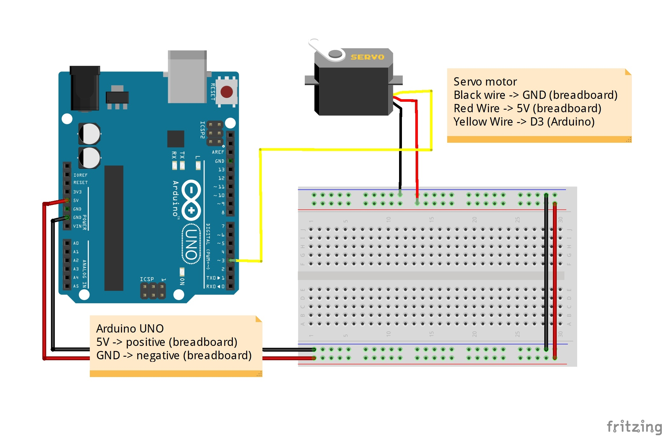

Slide 19
Servos with Cylon.js
Setting up requirements
"use strict";
var Cylon = require('cylon');
The “main” method
Cylon.robot({
//main code here
}).start();

Slide 20
Servos with Cylon.js
Defining the connections (NOTE: CHANGE THE PORT)
connections: {
arduino: { adaptor: 'firmata', port: 'COM3' }
},
Defining the devices
devices: {
servo: { driver: 'servo', pin: 3 }
},

Slide 21
Servos with Cylon.js
Making the servos rotate left to right every second
work: function(my) {
var angle = 0 ;
my.servo.angle(angle);
every((1).second(), function() {
angle = angle + 180 ;
if (angle > 180) {
angle = 0
}
my.servo.angle(angle);
});
}

Slide 22
var Cylon = require("cylon");
Cylon.robot({
connections: {
arduino: { adaptor: 'firmata', port: 'COM3' }
},
devices: {
servo: { driver: 'servo', pin: 3 }
},
work: function(my) {
var angle = 0 ;
my.servo.angle(angle);
every((1).second(), function() {
angle = angle + 180 ;
if (angle > 180) {
angle = 0
}
my.servo.angle(angle);
});
}
}).start();

Slide 23
Servos with Cylon.js
Make sure “Standard Firmata” has been uploaded on the Arduino
“npm install cylon-firmata cylon-gpio cylon-i2c”
To run the script using terminal:
node servos.js

Slide 24
Controlling servos with the keyboard
Setting up requirements
"use strict";
var Cylon = require('cylon');
The “main” method
Cylon.robot({
//main code here
}).start();

Slide 25
Controlling servos with the keyboard
Defining connections and devices
connections: {
arduino: { adaptor: 'firmata', port: 'COM3' },
keyboard: { adaptor: 'keyboard' }
},
devices: {
servo1: { driver: 'servo', pin: 3, connection: "arduino" },
keyboard: { driver: 'keyboard', connection: "keyboard" }
},

Slide 26
Controlling servos with the keyboard
Rotates the servos when the “a” key is pressed
work: function(my) {
var angle1 = 0 ; my.servo1.angle(angle1);
my.keyboard.on("a", function() {
if (angle1 == 0){
angle1 = 180;
my.servo1.angle(angle1);
} if (angle1 ==180) {
angle1 = 0;
my.servo1.angle(angle1);
}
});
}

Slide 27
"use strict";
var Cylon = require('cylon');
Cylon.robot({
// change the port below to match whatever your Arduino is actually plugged into
connections: {
arduino: { adaptor: 'firmata', port: 'COM3' },
keyboard: { adaptor: 'keyboard' }
},
devices: {
servo1: { driver: 'servo', pin: 3, connection: "arduino" }, keyboard: { driver: 'keyboard', connection: "keyboard" }
},
work: function(my) {
var angle1 = 0 ; my.servo1.angle(angle1);
my.keyboard.on("a", function() {
if (angle1 == 0){
angle1 = 180;
my.servo1.angle(angle1);
} if (angle1 ==180) {
angle1 = 0;
my.servo1.angle(angle1);
}
});
}
}).start();

Slide 28
Run the code

Slide 29
Now try it with 3 servos! :)

Slide 30

THANK YOU

